Slide 1

COOK IT YOURSELF E-Commerce
Güneş Başak Özgün 23521
Edin Guso 23435
Bora Mert Karal 24904
Demir Demirel 20586
Batur Gultekin 24188
Efe Karasıl 24118

Slide 2

Agenda
Project Content
Project Overview
Solution Architecture
Future Work
Conclusion

Slide 3
Project Content
Customer view
Administrative roles
Sales Manager
Product Manager

Slide 4










Customer View
2 factor authentication register and login system
Shopping without login step
Email for invoice, order status and campaigns
Fully informed payment system with order management
Comment and rate orders
Choose recipes using more than 5 filters
Save multiple addresses for convenient shopping experience
Choose among recommended recipes
Customizable profile page for easy shopping experience
Push notifications on the app for updates

Slide 5








Sales Manager View
Analyze sales through monthly sales graph
Review top 5-10-15 best selling recipes in a graph
Review top 5-10-15 customers all time
Deploy campaigns for meal types or specific recipe
Generate campaign banners and codes to be display on the main page
Send push notifications for order updates and campaigns
Review orders, change their status and delivery address
2 factor authentication login system

Slide 6





Product Manager View
Add, remove or update recipes, instructions and pictures
Add and remove meal categories
Change the price of recipes
Review and approve comments prior publishing
2 factor authentication login system

Slide 7
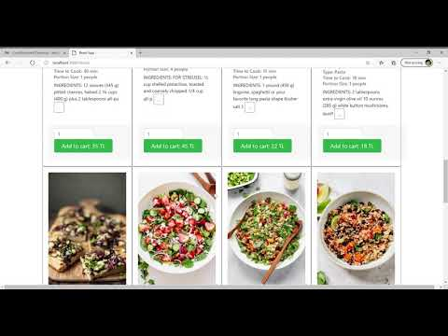
Project Overview

Slide 8
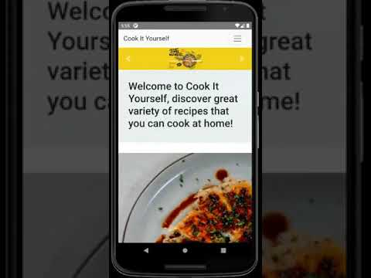
Order Demonstration

Slide 9

Notification Demonstration

Slide 10






Solution Architecture
SQLite: Excellent performance due to its lightweight architecture, easy setup and administration, pairs well with Django
Django: Fast, scalable and versatile, great variety of professional components, very useful admin panel
React: Many professional developer tools, helpful community, fast rendering.
Reactstrap: Includes many different beautifully designed React components, Makes the design process so much faster
React Native: Support for third party plugins, great performance, and similarity to React
React Native WebView: Allows React Web Apps to work on mobile as well, speeds up the project and reduces the cost.
Database
Back-end
Front-end (Web)
Front-end (Mobile)
React Native WebView

Slide 11

Solution Architecture
Campaign deployment and Notification system:
Firebase and Smtp.Gmail used to announce the campaign.
User can select subscribe to campaigns while registering.
Push notifications are applicable in any platform.
Invoice :
Personalised invoices created and sent to customer
Personal informations
Delivery informations
Recipe, quantity, sub-total price informations
Determine used coupons and calculate total price
Two factor Authentication:
For confirming registration
For login system of all user types

Slide 12

Solution Architecture
Recommendation:
Third party API called Recombee used to receive recommendations.
We recommend products based on user inputs.
What input parameters are?
Adding to cart, deleting from cart.
Visiting a product.
Purchasing a product.
User related informations
Product related informations
What is our output?
5 possible product offers for certain customer or product.

Slide 13


Future Work
Future features for the customer view part
Photograph of recipes they cook can be shared by customers in the comment / review section
Cooking/preparation videos of the recipes can be seen when customers press the product.
Option to share on social media platforms
Live chat for help and support
Notes:
What else your project may provide to its users in the future ?
What would you implement in the next version of your project ?
Photograph of recipes can be shared by customers

Slide 14
Future Work
Future features for the sales/product managers
Search Engine Optimization (SEO) features for products and pages
Deploying special campaigns / promotions for the most shoppers
Most viewed products Reports / Charts
Notes:
What else your project may provide to its users in the future ?
What would you implement in the next version of your project ?
Photograph of recipes can be shared by customers

Slide 15



Conclusion
Benefits of the project:
As a close-knit team we learned how to work in agile principles and adapt for Scrum process while working on a software project.
During Scrum, we were good at:
Relations and communications with Product Owner
Pair Programming
Both Bottom Up & Top Down approaches
As final thoughts, our project is:
Expandable
Applicable for different products and market
Software-wise ready to become a startup

